Slide 1
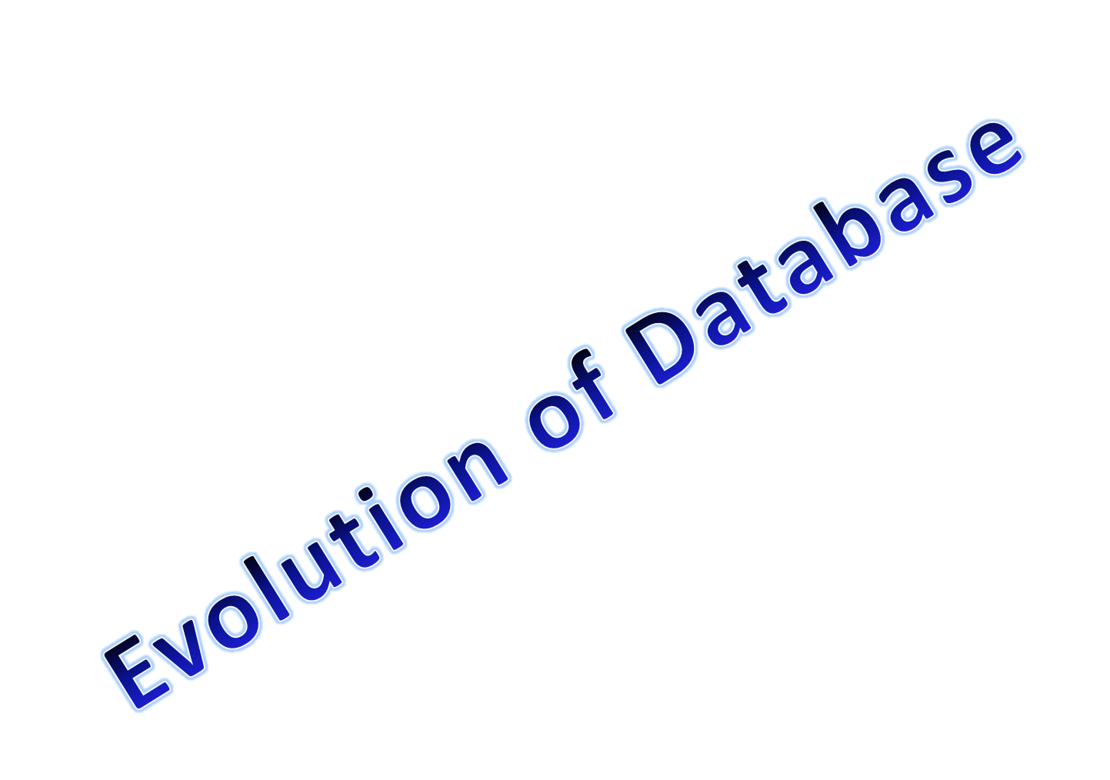

Slide 2

In earlier days, information were hand written.
With the advent of computers , information were stored
using file system.
But now, overcoming the disadvantages of file system,
data are stored in computers using DBMS.

Slide 3


Slide 4
Here each user defines and implements the files needed for a
specific s/w application as part of programming the application
resulting in data redundancy and wastage of storage space.
Application programs for a particular file system are constrained
to work with only one specific database, whose structure is
declared in the application program in a particular language
such as C++, COBOL, etc.
The structure of data files is embedded in the application program,
so any change in the structure of a file require changing all
program, that access this file.
4. Setting up a relation between two file system is not possible,
as there is no key concept in file system.
5. Data sharing is not possible in normal file systems.

Slide 5

A single repository of data is maintained that is defined once and
then is accessed by various users.
The DBMS software must work equally with any number of database
application.
The structure of data files is stored in the DBMS catalogue
separately from the access programs. This is called program
data independence.
Relationship can be established between two or more tables in
database.
Data sharing is possible in DBMS.
Thus ,due to all these reasons DBMS has overpowered File system.

